Slide 1
Model Interpretation
From: Christoph Molnar. Interpretable Machine Learning. 3rd edition, online book. https://christophm.github.io/interpretable-ml-book

Slide 2
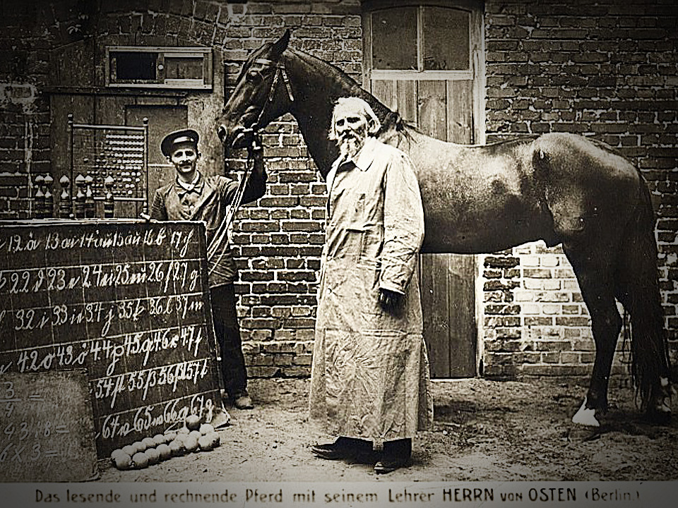
Clever Hans
Interesting story to read: https://en.wikipedia.org/wiki/Clever_Hans

Slide 3
Why do we need interpretability
A loan model rejects an applicant.
A medical model predicts high risk.
A student-performance model flags a student.
A fraud model blocks a transaction.
Accuracy is not enough when decisions affect people, trust, debugging, or scientific understanding.

Slide 4
Why do we need interpretability
Real-world decision
Human consequences
Accuracy / F1 / RMSE
Core tension
Prediction answers “what”.
Interpretation asks how the model behaves and where it may fail.
Debug the model and data pipeline
Audit unexpected or harmful behavior
Understand what was learned from data
Communicate model behavior to stakeholders
Molnar, Ch. 2

Slide 5
The three goals of interpretation
Goal | Question | Example
Improve the model | What went wrong? | The model uses snow to classify wolves.
Justify predictions | Can stakeholders understand the model’s output? | A bank needs to justify a rejection.
Discover insights | What has the model learned about the domain? | Which features relate to water supply, disease risk, churn, etc.?
Same model, different goal → different interpretation method.

Slide 6
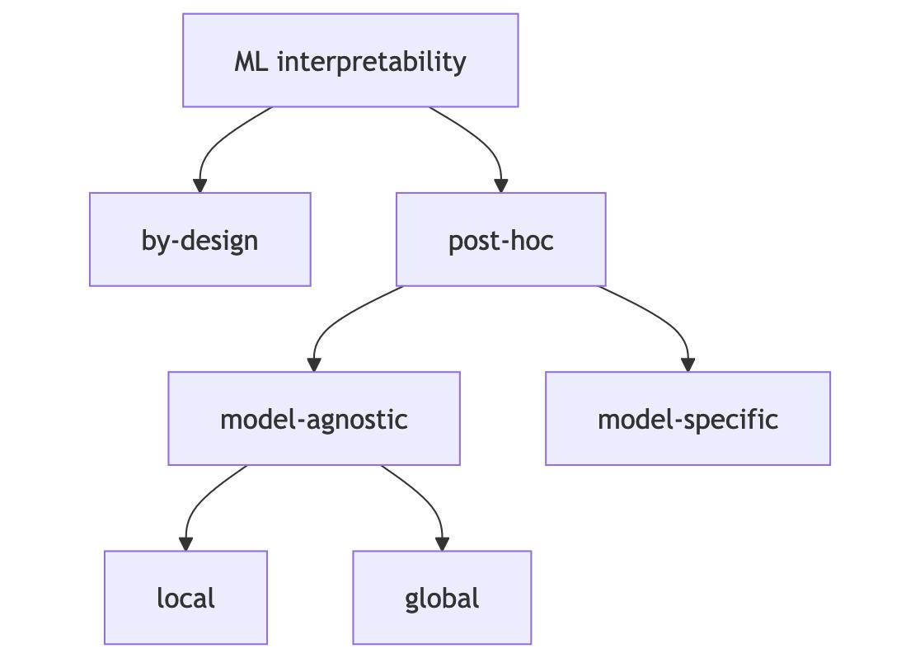
The second design choice is whether we want to build / use a model-specific method or just simply use a model-agnostic one.
The first design choice is whether we want an interpretable model from the beginning, or whether we want to interpret a more complex trained model afterward.

Slide 7
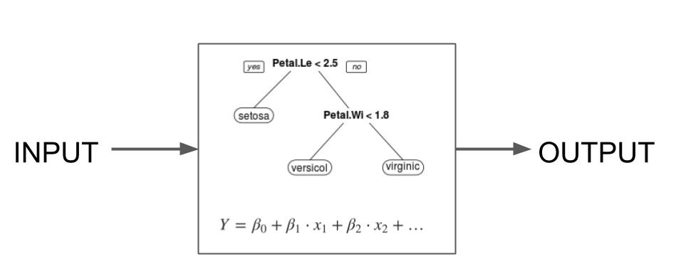
Interpretable models by design
Linear / logistic
coefficients as directional associations
Decision trees
paths as if–then rules
Rule models
compact rule sets
Critical caveats
• Correlated features complicate coefficients
• Large trees stop being readable
• Feature scaling changes coefficient magnitudes
• Interpretable does not mean causal

Slide 8
Post-hoc interpretation
Model-agnostic: work with many model types
Model-specific: designed for a particular model family
Global: study overall model behavior
Local: study one prediction or one instance

Slide 9
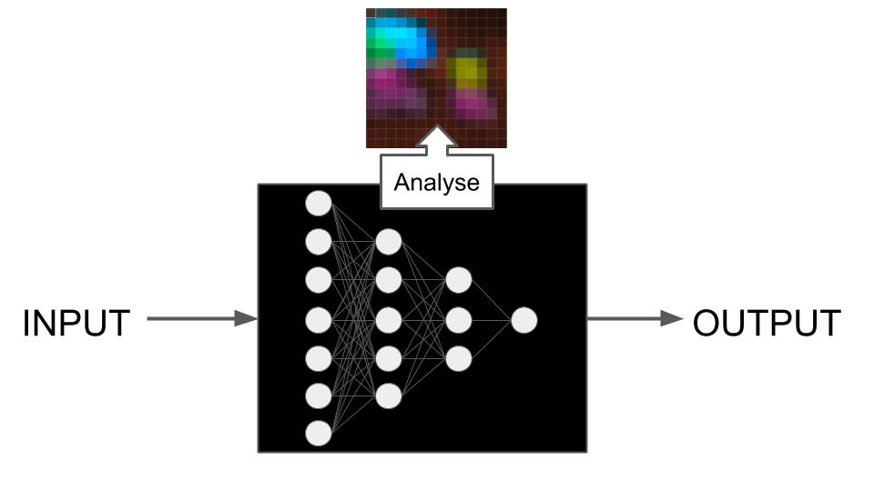
Model-specific post-hoc methods

Slide 10
NeuralNetwork-specific methods
Learned Features: What features did the neural network learn?
Saliency Maps: How did each pixel contribute to a particular prediction?
Concepts: Which concepts did the neural network learn?
Adversarial Examples: How can we fool the neural network?
Influential Instances: How influential was a training data point for a given prediction?

Slide 11
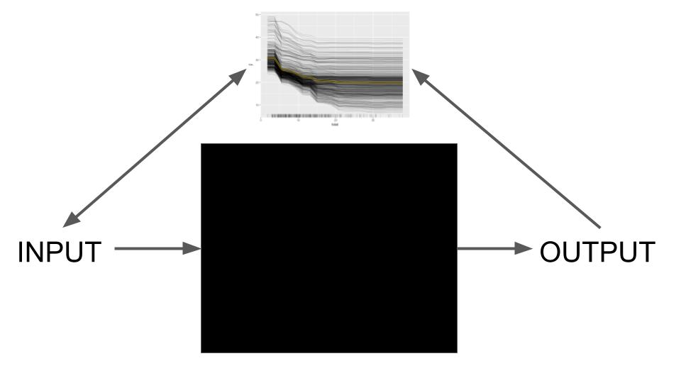
Model-agnostic post-hoc methods
Model-agnostic interpretation methods work with inputs and outputs and ignore model internals.

Slide 12
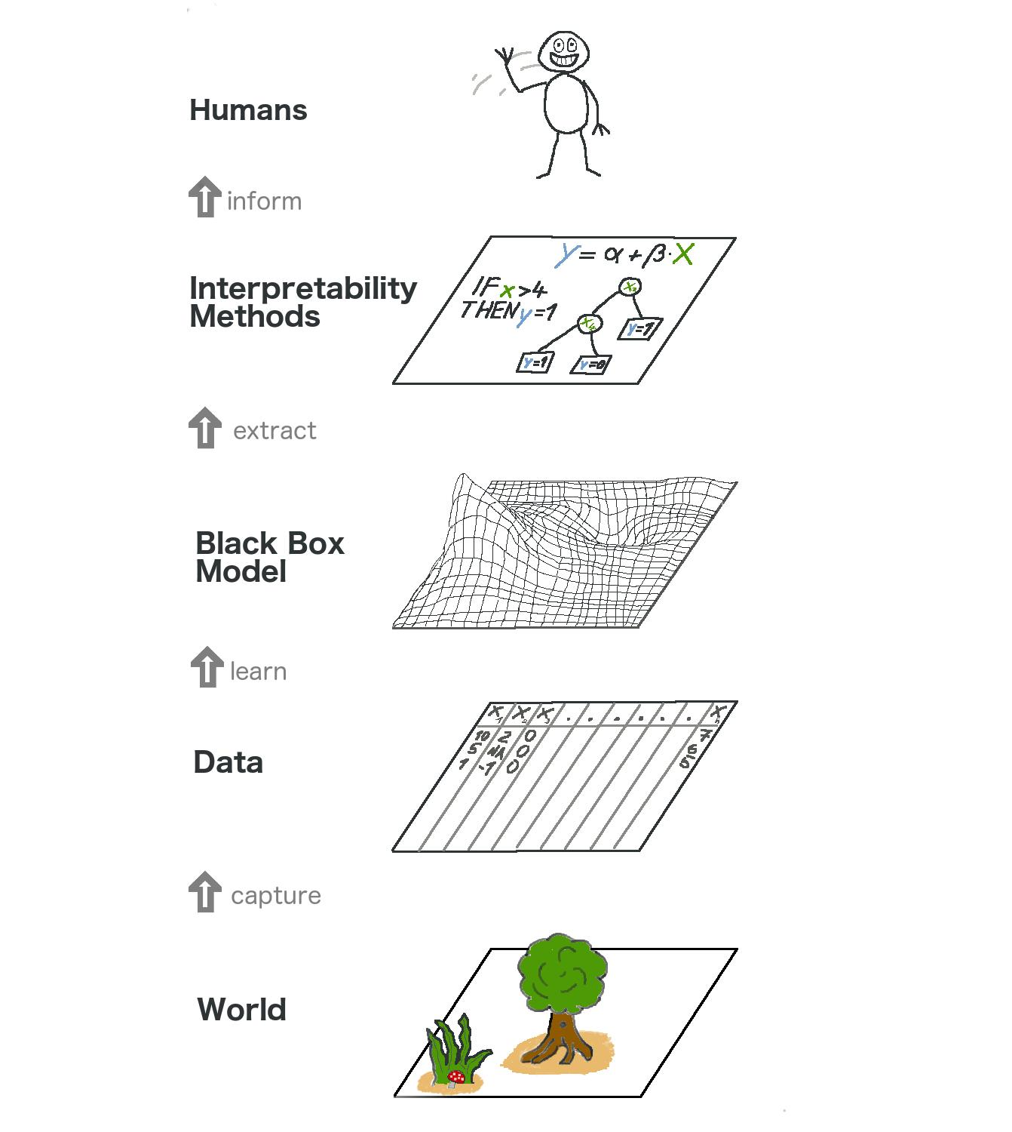
The big picture
The real world goes through many layers before it reaches the human in the form of explanations.

Slide 13
Model-agnostic interpretation: input–output probing
SIPA principle: sample → intervene → predict → aggregate
Sample
data
Intervene
on features
Predict
again
Aggregate
behavior
Human
interpretation
The model is treated like a black box: perturb inputs, observe predictions, aggregate results.
Molnar, Ch. 4

Slide 14
Global interpretation
Feature importance
Which variables matter for predictive performance?
Feature effects
How does prediction change as a feature changes?
Interactions
Does one feature’s effect depend on another?
income
debt
Caveat: global summaries can hide individual cases.
age
zip
Global methods summarize average model behavior over many data points.
Molnar, Ch. 19–24

Slide 15
Local interpretation
A specific instance
Trained model
Prediction
Local
interpretation
ICE
change one feature and watch one or many predictions
LIME
fit a simple local surrogate around one case
SHAP / Shapley
assign prediction differences to feature values
Counterfactuals
find a minimal change that flips the output
Local methods study one instance or one prediction at a time.
Molnar, Ch. 12–18

Slide 16
Representative global tool: permutation feature importance
Original data
model loss = low
Shuffle one feature
break its link to target
Loss increase
= importance
Simple and model-agnostic
Use held-out data to avoid overfitting artifacts
Correlated features require careful interpretation
Importance means predictive usefulness, not causality
Question: how much performance do we lose when one feature’s information is destroyed?
Molnar, Ch. 23
Notes:
The concept is really straightforward: A feature is “important” if shuffling its values increases the model error, because in this case, the model relied on the feature for the prediction. A feature is “unimportant” if shuffling its values leaves the model error unchanged, because in this case, the model ignored the feature for the prediction.

Slide 17
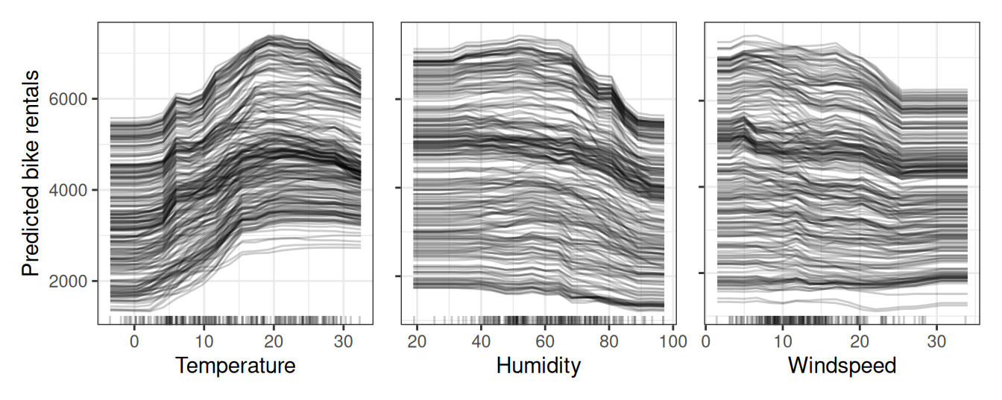
Representative local tool: ICE
Individual Conditional Expectation (ICE) plots display one line per instance that shows how the instance’s prediction changes when a feature changes.
Molnar, Ch. 13

Slide 18
Representative local tool: SHAP / Shapley values
Question: how do feature values move this prediction away from a reference prediction?
Main intuition
SHAP treats feature values as contributors to the prediction difference relative to a baseline.
Reference prediction
0.30
income
+0.25
age
+0.05
debt
−0.20
final
0.40
Caveats: baseline choice matters; dependent features are hard
The Shapley value allows contrastive explanations. Instead of comparing a prediction to the average prediction of the entire dataset, you could compare it to a subset or even to a single data point.
Molnar, Ch. 18

Slide 19
Counterfactual interpretation
Current case
Rejected loan
Change
debt − $2,000
Alternative case
Approved loan
Good counterfactuals are close to the original case
They should be realistic under the data distribution
They should avoid impossible or unethical changes
They are often highly intuitive for users
Question: what minimal realistic change would alter the model output?
Molnar, Ch. 15

Slide 20
Common pitfalls
Correlation ≠ causality
predictive patterns may not be causal
Proxy variables
removed sensitive features can reappear indirectly
Distribution shift
interpretations can change with the data
Overtrust
clean plots can make weak models look reliable
Audience mismatch
different stakeholders need different detail
Method mismatch
global and local methods answer different questions
A model interpretation is a claim about model behavior under assumptions.
Molnar, throughout

Slide 21
Takeaways
Interpretation is goal-dependent.
Interpretable-by-design models are strong baselines.
Post-hoc methods can be global or local.
Permutation importance measures performance loss when information is destroyed.
SHAP attributes a prediction difference to feature values.
Counterfactuals are contrastive and often useful for recourse.
Interpretation does not automatically give causality, fairness, or correctness.
Molnar, summary

